Slide 1
Offline Signature Verification with Convolutional Neural Networks

Slide 2
1.
What is a CNN?

Slide 3
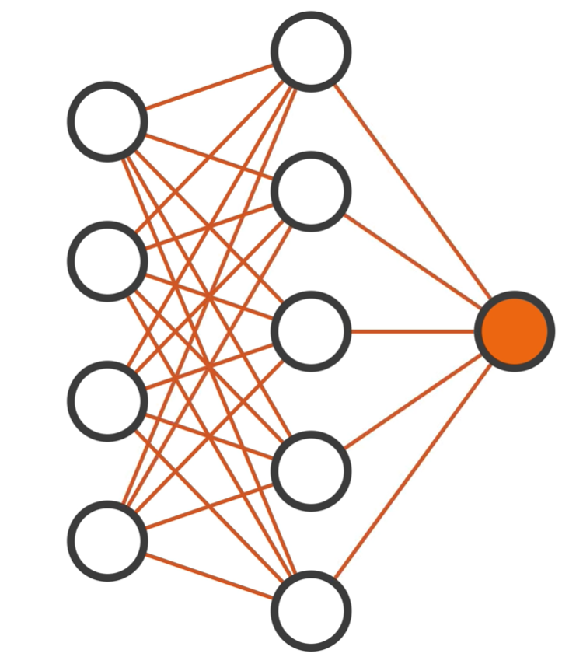
Input
Layer
Output
Layer
Hidden
Layer

Slide 4
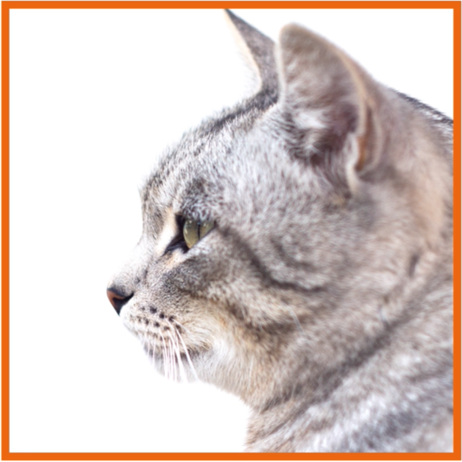
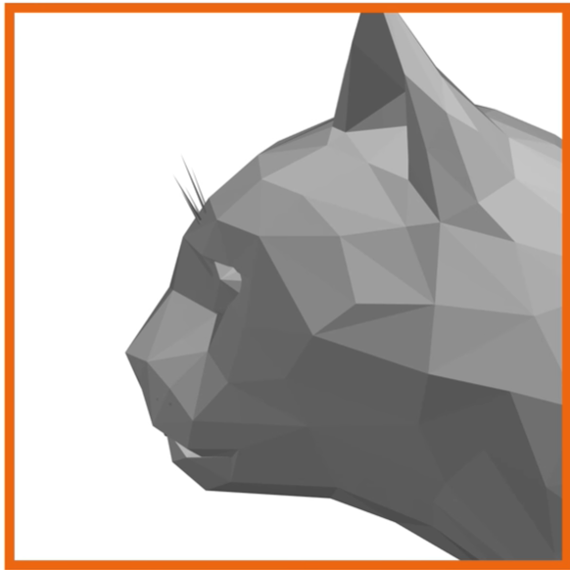
Filtering

Slide 5
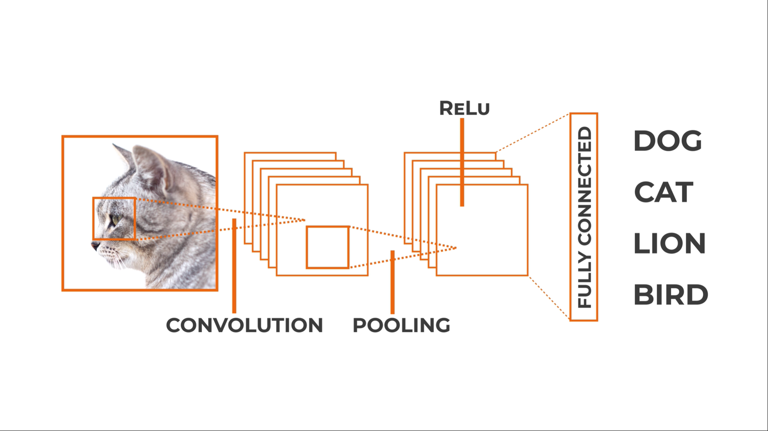
CNN Architecture

Slide 6
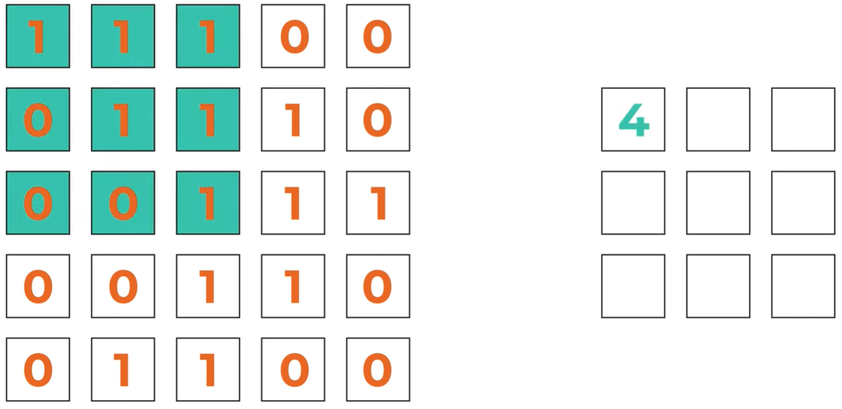
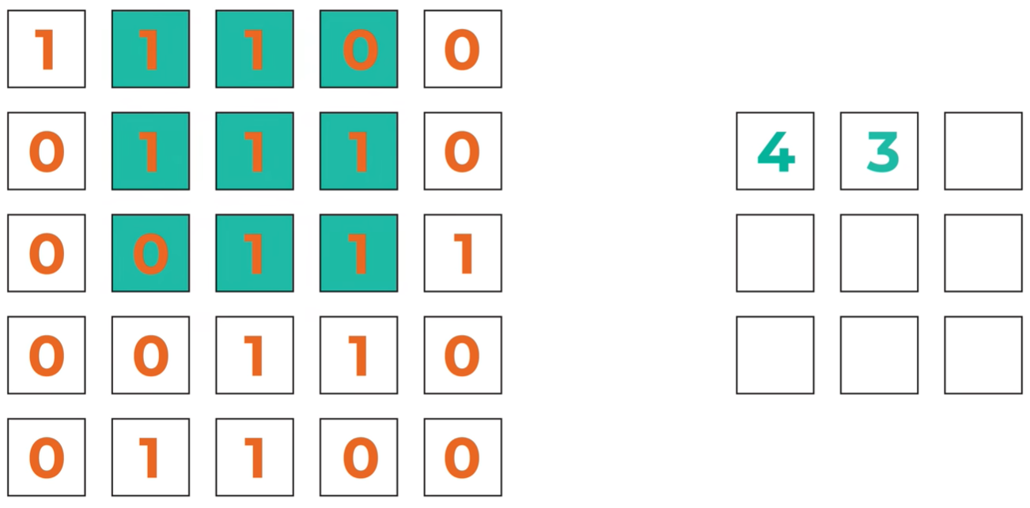
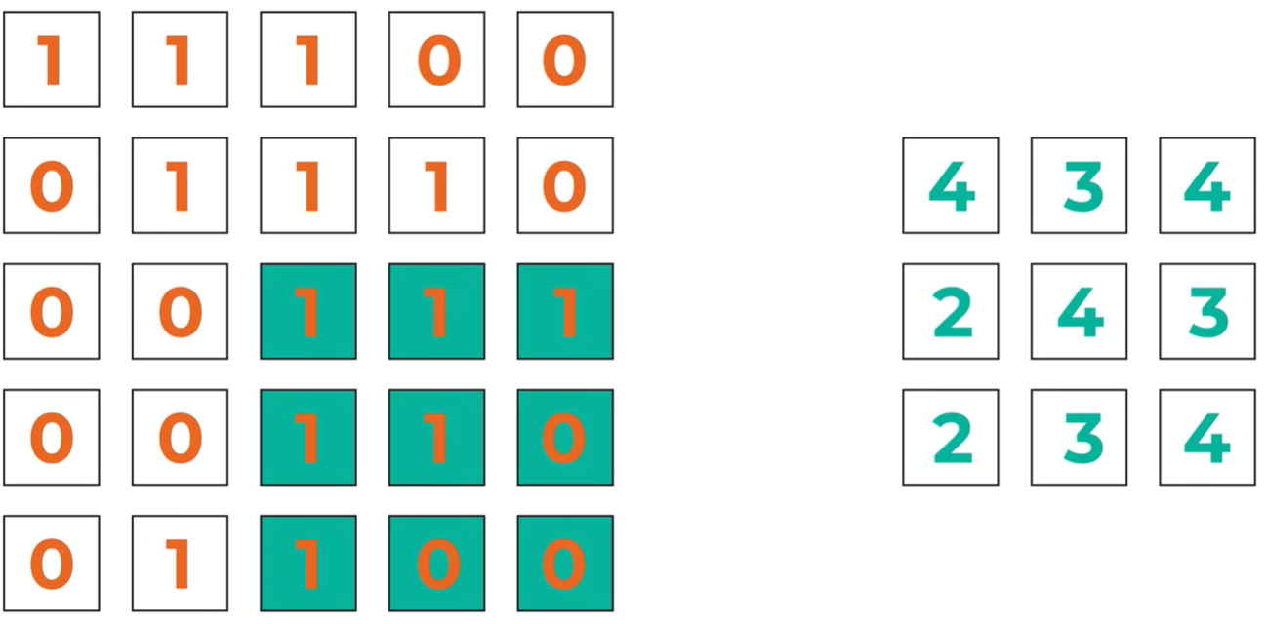
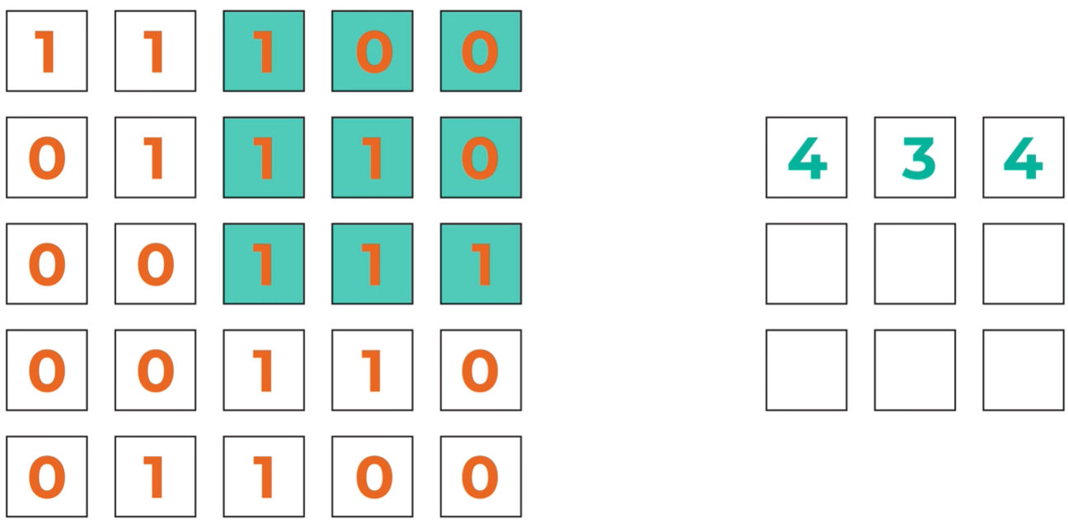
Convolution layer
Notes:
Filters

Slide 7
Convolution layer
Convolving
Filters
Padding
Stride
Flattening

Slide 8
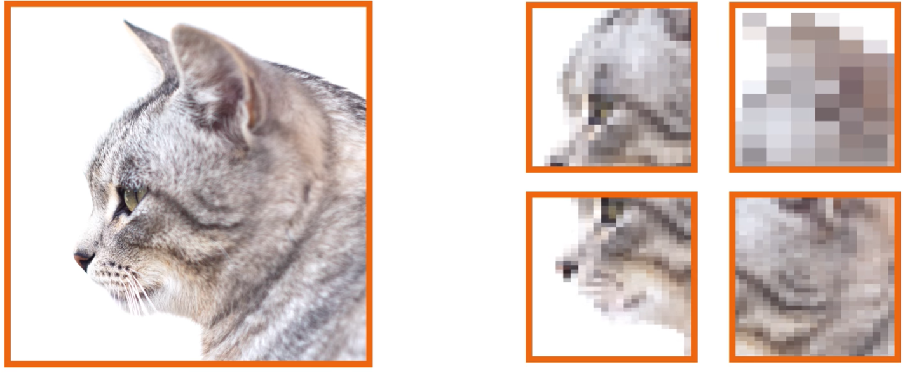
Pooling layer
Max pooling, average pooling…
Notes:
Reducing parameters, speeding up calculations 🡺 feature extraction

Slide 9
Fully connected layer
Classification
Linear data
Flattening

Slide 10
2.
Alvarez 2016

Slide 11
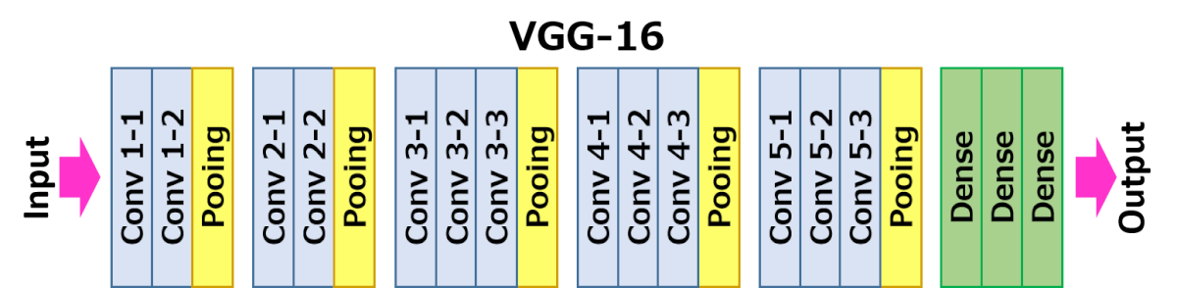
VGG 16 Architecture
Notes:
There are 13 convolutional layers, 5 Max Pooling layers and 3 Dense layers which sums up to 21 layers but only 16 weight layers.
Conv 1 has number of filters as 64 while Conv 2 has 128 filters, Conv 3 has 256 filters while Conv 4 and Conv 5 has 512 filters.

Slide 12
Loss function, transfer learning
Notes:
There are 13 convolutional layers, 5 Max Pooling layers and 3 Dense layers which sums up to 21 layers but only 16 weight layers.
Conv 1 has number of filters as 64 while Conv 2 has 128 filters, Conv 3 has 256 filters while Conv 4 and Conv 5 has 512 filters.

Slide 13
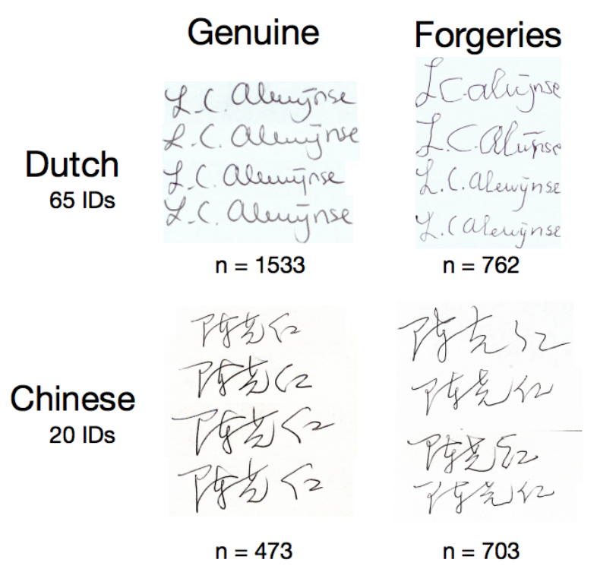
Datasets Used
SigComp 2011 dataset :
366 images of Dutch signers for 10 IDs.
576 images of Chinese signers for 10 IDs.
Notes:
There are 13 convolutional layers, 5 Max Pooling layers and 3 Dense layers which sums up to 21 layers but only 16 weight layers.
Conv 1 has number of filters as 64 while Conv 2 has 128 filters, Conv 3 has 256 filters while Conv 4 and Conv 5 has 512 filters.

Slide 14
Results (⅓)
All data in the SigCOMP dataset are labelled as either genuine or forged signatures without the identity of the signer.
Validation
Test
 | Dutch Result | Chinese Result
Accuracy | 97% | 95%
FAR | 3.6% | 4.7%
FRR | 3.6% | 5.6%
 | Dutch Result | Chinese Result
Accuracy | 94% | 88%
FAR | 13.32% | 8.2%
FRR | 3.13% | 18.2%
Notes:
They evaluate the performance of the network using 3 metrics: Accuracy, False Acceptance Rate, False Rejection Rate.
Higher accuracy is better and lower FAR and FRR are better. But the most important is to achieve low FAR scores

Slide 15
Results (⅔)
Training the network with the same dataset.
Validation and test sets : new people’s signatures and forgeries by new people not in the dataset.
Validation
Test
 | Dutch Result
Accuracy | 73%
FAR | 22.2%
FRR | 28.3%
 | Dutch Result
Accuracy | 76%
FAR | 28.6%
FRR | 21.8%
Notes:
They evaluate the performance of the network using 3 metrics: Accuracy, False Acceptance Rate, False Rejection Rate.
Higher accuracy is better and lower FAR and FRR are better. But the most important is to achieve low FAR scores

Slide 16
Results (3/3)
Writer-Dependant Comparison Task:
10 genuine signatures, 25 questioned signatures.
Goal: the network classify the questioned signatures
Validation
 | Dutch Result
Accuracy | 67.1%
FAR | 33%
FRR | 33%
Notes:
They evaluate the performance of the network using 3 metrics: Accuracy, False Acceptance Rate, False Rejection Rate.
Higher accuracy is better and lower FAR and FRR are better. But the most important is to achieve low FAR scores

Slide 17
3.
Haffeman 2018

Slide 19
4.
Tekerek 2019
Presented By KACHOURI Maraoune

Slide 20
Architecture
ZeroPadding 1-1
Conv 1-1
ZeroPadding 1-2
Conv 1-2
Pooling
ZeroPadding 1-3
Conv 2-1
ZeroPadding 1-4
Conv 2-2
ZeroPadding 1-5
Conv 2-3
Pooling
Dense 1-1
Dropout 0.5
Dense 1-2
Dropout 0.5
Dense 1-3

Slide 21
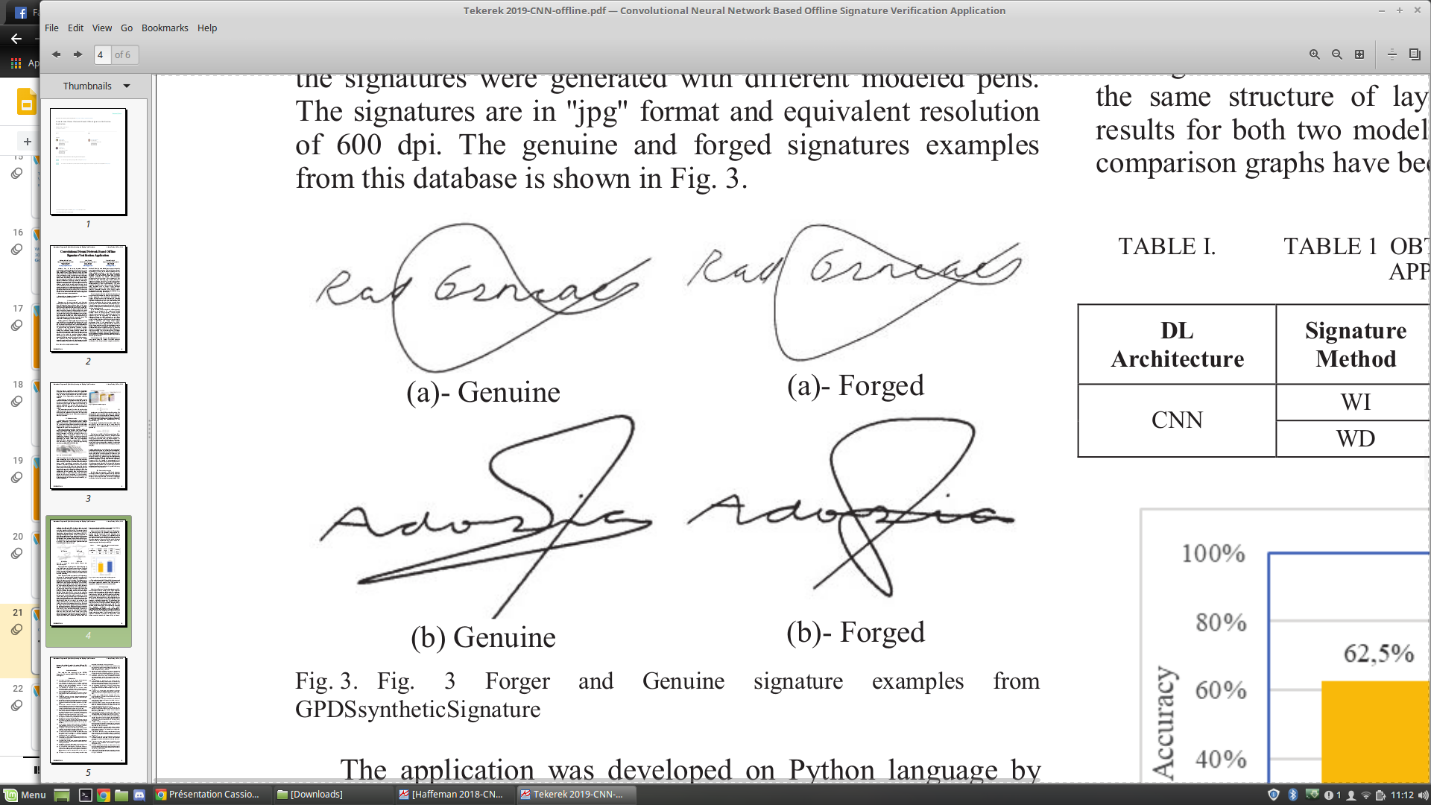
Datasets Used
GPDSsyntheticSignatures
4000 different individuals:
24 genuine signatures.
30 samples of forged signatures.
Notes:
There are 13 convolutional layers, 5 Max Pooling layers and 3 Dense layers which sums up to 21 layers but only 16 weight layers.
Conv 1 has number of filters as 64 while Conv 2 has 128 filters, Conv 3 has 256 filters while Conv 4 and Conv 5 has 512 filters.

Slide 22
Results
CNN was trained via WD and WI signatures.
 | WI | WD
Test data | 240 | 24
Training data | 300: 150 genuine + 150 forgeries | 30: 15 genuine + 15 forgeries
Accuracy | 62.5% | 75%
Notes:
They evaluate the performance of the network using 3 metrics: Accuracy, False Acceptance Rate, False Rejection Rate.
Higher accuracy is better and lower FAR and FRR are better. But the most important is to achieve low FAR scores

Slide 23
THANKS!
😉

